Slide 1



Slide 2

NATURE VIEW OF A TREE
leaves
branches
root

Slide 3

COMPUTER SCIENTIST’S VIEW
root
leaves
branches
nodes

Slide 4
WHAT IS A TREE
A tree is a finite nonempty set of elements.
It is an abstract model of a hierarchical structure.
consists of nodes with a parent-child relation.
Computers”R”Us
Sales
Manufacturing
R&D
US
International
Laptops
Desktops
Europe
Asia
Canada

Slide 5
TERMINOLOGY
Root: node without parent (A)
Siblings: nodes share the same parent
Internal node: node with at least one child (A, B, C, F)
External node (leaf ): node without children (E, I, J, K, G, H, D)
Ancestors of a node: parent, grandparent, grand-grandparent, etc.
Descendant of a node: child, grandchild, grand-grandchild, etc.
Depth of a node: number of ancestors
Height of a tree: maximum depth of any node (3)
Degree of a node: the number of its children
Degree of a tree: the maximum number of its node.
Subtree: tree consisting of a node and its descendants
A
subtree
B
C
D
E
F
G
H
I
J
K

Slide 6
STRUCTURE OF TREE
Every tree node:
object – useful information
children – pointers to its children
Data
Data
Φ
Φ
Data
Φ
Data
Φ
Φ
Data
Φ
Φ
Data
Φ
Φ
Data
Φ
Φ

Slide 7
LEFT CHILD,RIGHT SIBLING REPRESENTATION
Data
Left Child
Right Sibling
A
B
C
D
E
F
G
H
I
J
K
L

Slide 8
BINARY TREE
A binary tree is a tree with the following properties:
Each internal node has at most two children (degree of two)
The children of a node are an ordered pair
We call the children of an internal node left child and right child
Alternative recursive definition: a binary tree is either
a tree consisting of a single node, OR
a tree whose root has an ordered pair of children, each of which is a binary tree
Applications:
arithmetic expressions
decision processes
searching
A
B
C
D
E
F
G
H
I

Slide 9
Skewed Binary Tree
Complete Binary Tree
A
A
1
A
B
B
2
B
C
C
3
D
E
F
G
D
E
4
H
I
5

Slide 10
DATA STRUCTURE FOR BINARY TREE
A node is represented by an object storing
Element
Parent node
Left child node
Right child node
∅
B
∅
∅
A
D
B
∅
∅
∅
∅
A
D
C
E
C
E

Slide 11
LINKED REPRESENTATION
typedef struct node *tree_pointer;
typedef struct node {
int data;
tree_pointer left_child, right_child;
};
data
left_child
data
right_child
left_child
right_child

Slide 12
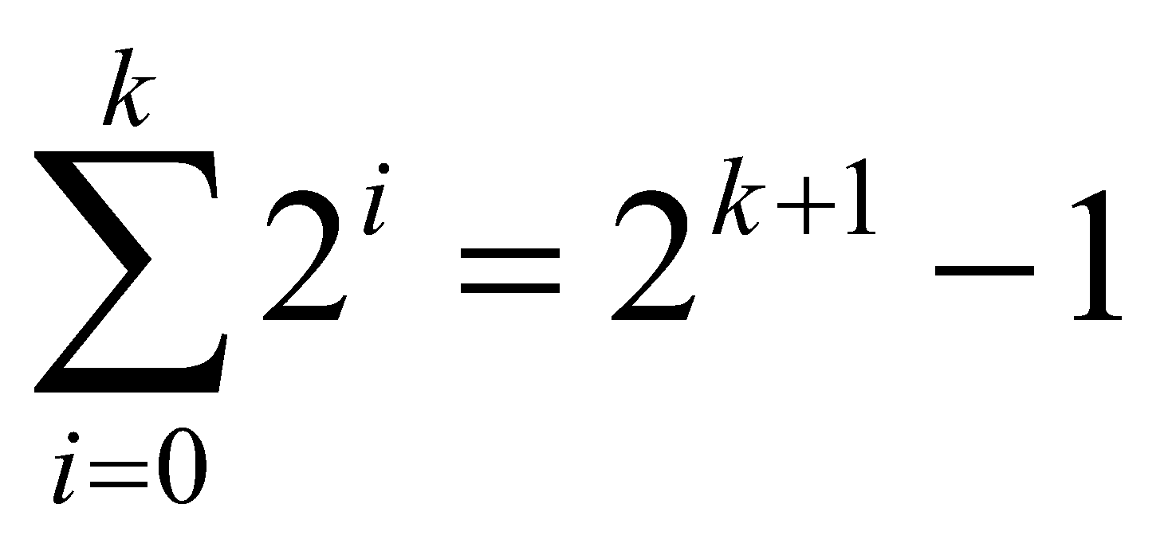
MAXIMUM NUMBER OF NODES IN A BINARY TREE
The maximum number of nodes on depth i of a binary tree is 2^{i}, i>=0.
The maximum nubmer of nodes in a binary tree of height k is 2^{k+1}-1, k>=0.
Prove by induction.

Slide 13
NODE NUMBER PROPERTIES
1
2
3
4
5
6
7
8
9
10
11
12
13
14
15
Left child of node i is node 2i, unless 2i > n, where n is the number of nodes.
If 2i > n, node i has no left child.

Slide 14
1
2
3
4
5
6
7
8
9
10
11
12
13
14
15
Right child of node i is node 2i+1, unless 2i+1 > n, where n is the number of nodes.
If 2i+1 > n, node i has no right child.

Slide 15
COMPLETE BINARY TREE
A labeled binary tree containing the labels 1 to n with root 1, branches leading to nodes labeled 2 and 3, branches from these leading to 4, 5 and 6, 7, respectively, and so on.
A binary tree with n nodes and level k is complete iff its nodes correspond to the nodes numbered from 1 to n in the full binary tree of level k.
1
1
2
3
2
3
4
5
6
7
4
5
6
7
8
9
10
11
12
13
14
15
8
9
Complete binary tree
Full binary tree of depth 3

Slide 16
BINARY TREE TRAVERSALS
Let l, R, and r stand for moving left, visiting the node, and moving right.
There are six possible combinations of traversal
lRr, lrR, Rlr, Rrl, rRl, rlR
Adopt convention that we traverse left before right, only 3 traversals remain
lRr, lrR, Rlr
inorder, postorder, preorder

Slide 17
PRE-ORDER TRAVERSAL
In preorder, the root is visited first
Here’s a preorder traversal to print out all the elements in the binary tree:
void printPreorder(struct node* node)
{
if (node == NULL)
return;
/* first print data of node */
printf("%d ", node->data);
/* then recur on left sutree */
printPreorder(node->left);
/* now recur on right subtree */
printPreorder(node->right);
}

Slide 18
IN-ORDER TRAVERSAL
In in-order, the root is visited in the middle
Here’s an inorder traversal to print out all the elements in the binary tree:
void printInorder(struct node* node)
{
if (node == NULL)
return;
/* first recur on left child */
printInorder(node->left);
/* then print the data of node */
printf("%d ", node->data);
/* now recur on right child */
printInorder(node->right);
}

Slide 19
POST-ORDER TRAVERSAL
In postorder, the root is visited last
Here’s a postorder traversal to print out all the elements in the binary tree:
void printpostorder(struct node* node)
{
if (node == NULL)
return;
/* first recur on left child */
printpostorder(node->left);
/* now recur on right child */
printpostorder(node->right);
/* then print the data of node */
printf("%d ", node->data);
}

Slide 20
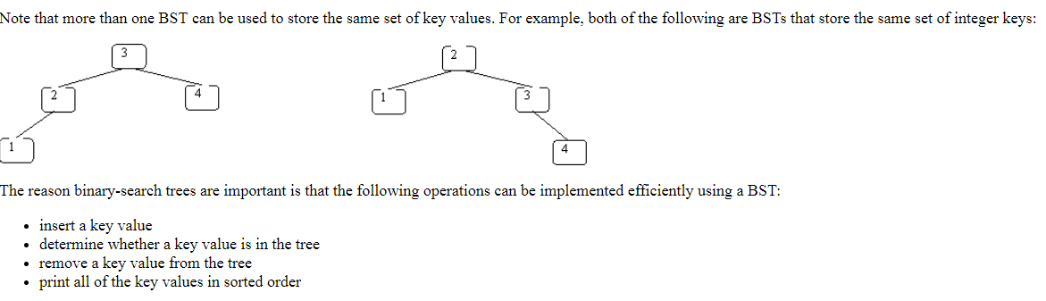
INTRODUCTION TO BST
An important special kind of binary tree is binary search tree(BST).In a BST, each node stores some information including a unique key value, and perhaps some associated data. A binary tree is a BST iff, for every node in the tree:
All keys in n’s left subtree are less than the key in n, and
All keys in n’s right subtree are greater than the key in n.
NOTE: If duplicate keys are allowed, then nodes with values that are equal to the key in node n can be either in n’s left subtree or in its right subtree(but not both).In these notes,we will assume that duplicates are not allowed.

Slide 21
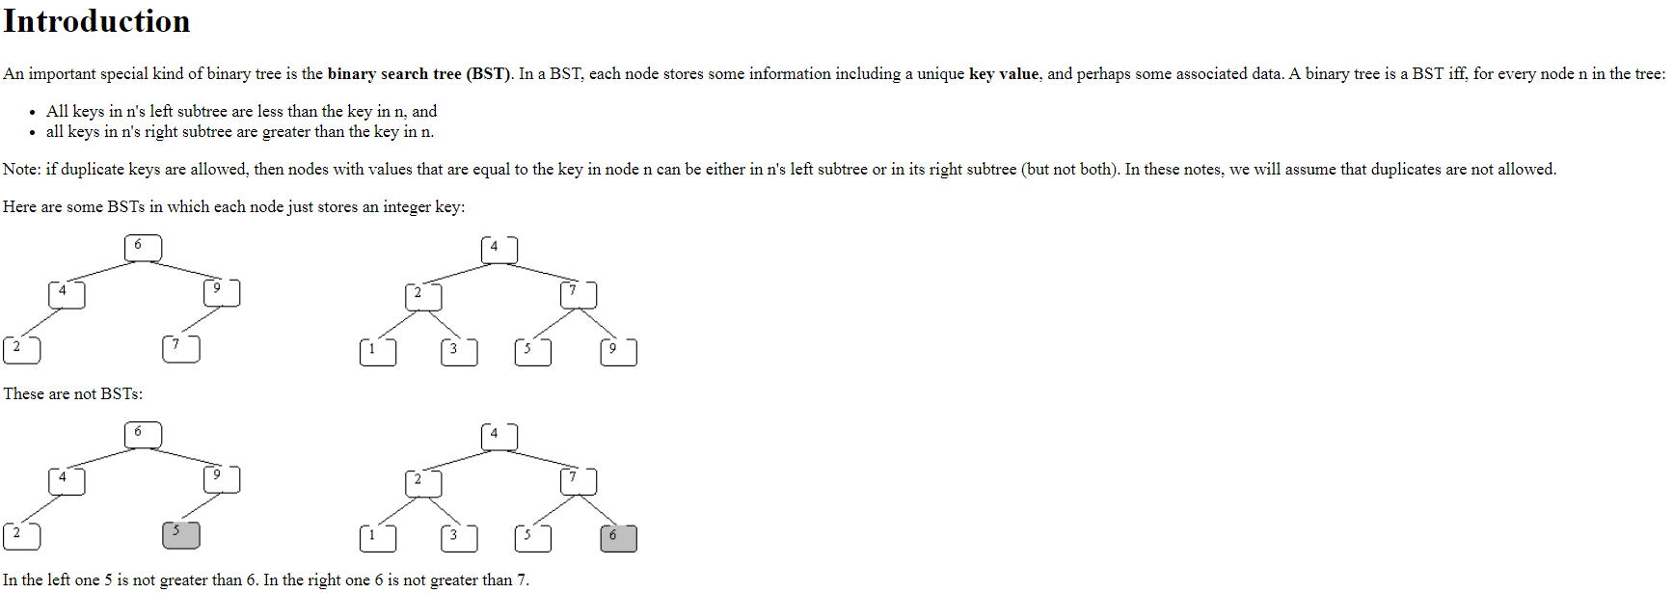

Slide 22
IMPORTANCE OF BST
The reason binary-search trees are important is that the following operations can be implemented efficiently using a BST:
Insert a key value.
Determine whether a key value is in the tree.
Remove a key value from the tree.
Print all the key values in sorted order.

Slide 23
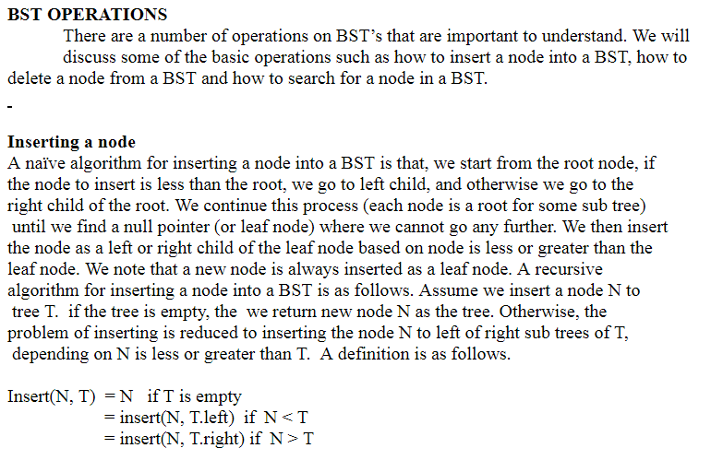
INSERTING A NODE

Slide 24
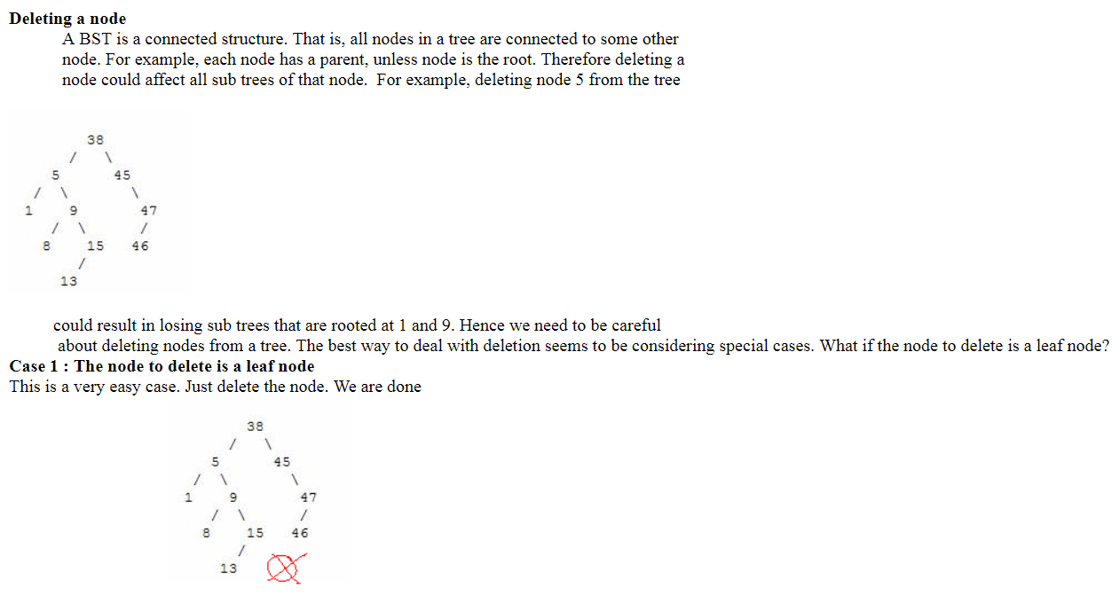
DELETING A NODE

Slide 26
